Slide 1




Jazz Instrument Matching Game
Justification & Defence of Personal Contributions to Human-Centered Design
PROJECT TITLE
TARGET PERSONA
PLATFORM TARGET
ASSESSMENT FOCUS

Slide 2




Project Scope & Core Goals
Overarching Team Goals
Personal Contribution Scope
12 Gamified Jazz Levels: Introduce early childhood learners to iconic jazz history through interactive matching mechanics.
3 Core Interactive Modules: Responsible for Miles Davis (Trumpet), Thelonious Monk (Piano), and John Coltrane (Saxophone).
KOPO Architecture Alignment: Standardize layouts featuring 4 answer cards, 4 hint cues, drop boxes, and score wheels.
UX & Multimodal Feedback: Designed character animations, sound triggers, and error recovery mechanics.
Cognitive Load Reduction: Reframe abstract cultural narratives into engaging, accessible digital interactions.
Iterative Figma Prototyping: Authored Lo-Fi to Hi-Fi clickable prototypes and led KOPO platform technical spikes.

Slide 3






Personal Contribution Portfolio
US 1: Miles Davis (Trumpet)
US 2: Thelonious Monk (Piano)
US 3: Coltrane Sax Match
Story: As a student, I want to match the trumpet to Miles Davis to hear his cool jazz sound.
Story: As a student, I want to match playful piano keys to Monk to trigger a fun jazz dance.
Story: As a student, I want to match the golden saxophone to John Coltrane to learn instrument shapes.
Acceptance Criteria: Cartoon Miles wearing cool sunglasses, sparkle effect on drop, bright trumpet tune trigger, friendly "uh-oh" bounce back on error.
Acceptance Criteria: Cartoon Monk wearing his signature hat, playful dance animation, voiceover reinforcement: "Great job! Monk plays piano!"
Acceptance Criteria: High-contrast golden saxophone illustration, 5-second smooth jazz melody cue, visual stroke/outline hints for cognitive guidance.

Slide 4

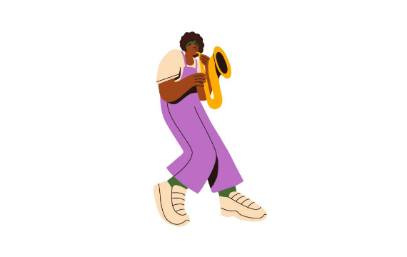
Sprint Pilot 1: Miles Davis Trumpet Match
Key Decisions & Trade-offs
Decision: Refactored archival historical photos into friendly cartoon character representations with distinct accessories (cool sunglasses).
Trade-off: Lowered historical photo realism in exchange for age-appropriate visual recognition and reduced perceptual friction (Norman, 2013).
Multimodal Cues: Successful drag-and-drop triggers a sparkle visual animation and an iconic audio trumpet clip.

Slide 5

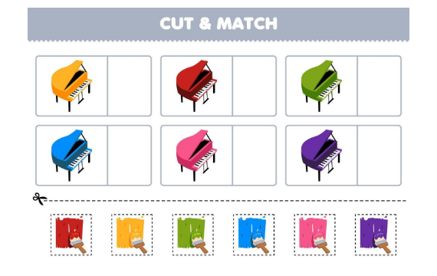
Sprint Pilot 2: Thelonious Monk Piano Match
Key Decisions & Trade-offs
Decision: Created character dance animation upon correct instrument association with voiceover reinforcement ("Great job! Monk plays piano!").
Trade-off: Increased asset rendering size on the KOPO engine, balanced by running technical spikes to optimize sprite compression.
Non-Punitive Feedback: Drag errors trigger a gentle "bounce-back" animation accompanied by a soft "uh-oh" chime to preserve confidence.

Slide 6
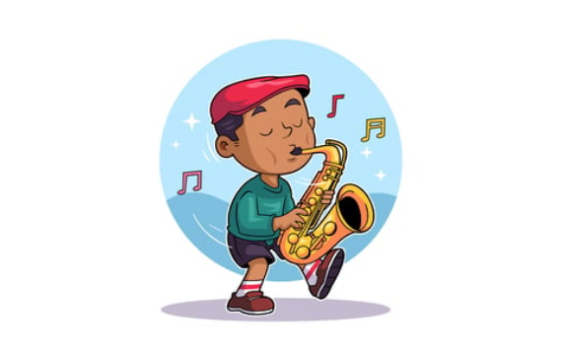
Sprint Pilot 3: Coltrane Saxophone Match
Key Decisions & Trade-offs
Decision: Added bold high-contrast outlines/strokes around the golden saxophone answer card and hint drop-boxes.
Trade-off: Slightly increased visual density, but drastically improved spatial affordance for 5-year-old motor skills.
Pedagogical Goal: Enabled early childhood learners to distinguish complex brass instrument silhouettes effortlessly.

Slide 7
Sprint Iterations Comparison
Sprint Pilot | Focus & Artifacts | User Feedback & Findings | Engineering Adaptation
Sprint 1 | Miles Davis Trumpet Level & Wireframes | Historical photos confused 5-year-olds; high drop-off. | Shifted to cartoon illustrations with signature traits.
Sprint 2 | Thelonious Monk & Audio Voiceovers | Hesitation during matching tasks; static cards felt dry. | Integrated dancing animations & voiceover praise.
Sprint 3 | Coltrane Sax & KOPO Architecture Spikes | Missed drop-zones due to imprecise finger dragging. | Added thick stroke outlines & enlarged drop targets.

Slide 8

Design Impact & Justification
Empirical Justification & Human Factors
100%
Cognitive Load Optimization: Replacing dense historical photos with high-contrast cartoon figures reduced perceptual processing demands for 6-year-olds (Norman, 2013).
Confidence Preservation: Immediate auditory cues ("uh-oh" chime) and gentle bounce-back animations eliminated failure anxiety during drag errors.
Non-Punitive Feedback Loop
Multimodal Learning: Simultaneous visual sparkle effects, audio tunes, and voiceovers reinforced correct audio-visual associations.

Slide 9


Key Trade-Offs & Constraints
Historical Realism vs. Cognitive Accessibility
Full Scope (12 Figures) vs. Timebox Constraint
Trade-Off: Compromised strict archival photo authenticity in favor of simplified cartoon representations.
Trade-Off: Balancing extensive content coverage with strict sprint delivery deadlines.
Rationale: Kindergarten learners process vibrant, high-contrast shapes far more effectively. Lowering cognitive friction was prioritized to achieve core pedagogical goals (Piaget, 1962).
Rationale: Systematically built reusable modular UI components and template assets in Figma. Accelerated asset production without compromising historical diversity.

Slide 10




SCRUM Development Milestones
Sprint 2
Final Defence
Audio integration & dance animation triggers.
Usability verification & Definition of Done audit.
Sprint 1
Sprint 3
Research & cartoon character design in Figma.
KOPO platform integration & stroke hints.

Slide 11
Self-Reflection & Future SCRUM Improvements
Communication & Team Synergy: Maintained daily async check-ins; resolved KOPO UI layout discrepancies early in the sprint cycle.
Goal Achievement: Successfully delivered all 3 assigned user stories fulfilling 100% of acceptance criteria and Definition of Done standards.
Applying SCRUM Moving Forward: Incorporate formal peer design reviews during Sprint Planning to refine asset reusable specs earlier.
Enhanced Automated Testing: Establish automated asset validation scripts for KOPO game deployment to reduce manual review overhead.

Slide 12


Conclusion & Defence Links
Thank you for reviewing my CP5046 Individual Video Defence Presentation.
Figma Interactive Prototype:
View Figma Design Artifacts
KOPO Live Game Engine:
Play KOPO Jazz Matching Game

Slide 13



Image Sources
https://media.istockphoto.com/id/2149837657/vector/saxophonist-plays-music-on-wind-instrument-performs-in-jazz-concert-musician-hold-gold.jpg?s=612x612&w=0&k=20&c=r7iv9L_p9rabzwDVXZhQjwnM7NYziGRNPvEGrn2Jzi8=
Source: www.istockphoto.com
https://static.vecteezy.com/system/resources/previews/013/696/397/non_2x/education-game-for-children-cut-and-match-the-same-color-of-cartoon-piano-printable-music-instrument-worksheet-vector.jpg
Source: www.vecteezy.com
https://elements-resized.envatousercontent.com/elements-cover-images/54032082-3417-417c-b1e7-f3846b6a495a?w=433&cf_fit=scale-down&q=85&format=auto&s=c298c55f5da30a47d3385b00f66be5f4858927f014fb85a61c78468f38117edb
Source: elements.envato.com

